Slide 1
Lecture Notes
The Normal Distribution
Prof. Welz, Gary
OER – www.helpyourmath.com

Slide 2
z-Scores – Calculating a given data value’s distance from the population mean
The z-score of a data value represents its distance above or below the mean measured in standard deviations.
The z-score formula is
$$z=\frac{x−μ}{σ}$$
Where x is the given data value, the lower case Greek letter mu written as “μ” is the population mean and the lower case Greek letter sigma written as “$σ$” is the population standard deviation.

Slide 3
Find the z-score for a given data value, mean and standard deviation
Suppose you are told someone named Mr. Smith weighs 158 pounds, that the mean weight of the population is 150 pounds and that the standard deviation is 8 pounds.
Then Mr. Smith’s z-score is
Z $=\frac{158−150}{8}$ $=\frac{8}{8}$
$$=1 standard deviation above the mean$$

Slide 4

We can also solve for $σ$ or $μ$ given the other two values using the formulas:
$σ=\frac{x−μ}{z}$
$$μ=x−zσ$$

Slide 5
z-Score for a sample mean and sample standard deviation
We use the population mean and standard deviation in most applications, but when we are working with a sample mean and sample standard deviation the formula is
$$z=\frac{\begin{aligned} _ \\ x−x\end{aligned}}{s}$$
Again x is the data value, x with a bar over the top is the sample mean and s is the sample standard deviation.

Slide 6
The Normal Distribution
Many data sets that we commonly use like those for the heights, weights and IQ’s are said to be distributed “normally” or to be examples of a normal distribution. Such a distribution has the following properties:
The mean, mode and median are all equal.
The curve is symmetric about the center, in other words, around the mean.
Exactly half of the values are to the left of the center and exactly half are to the right.
The total area under the curve is 1.000 or 100.0%.

Slide 7
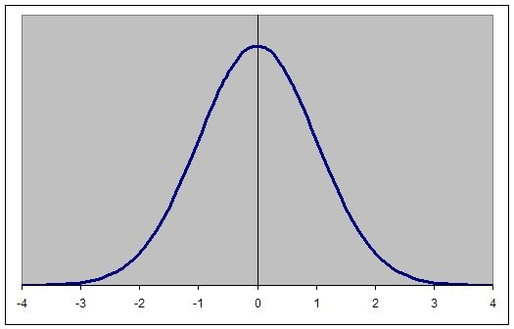
The Standard Normal Distribution which is also called the “Bell Curve”
This Photo by Unknown Author is licensed under CC BY-SA

Slide 8
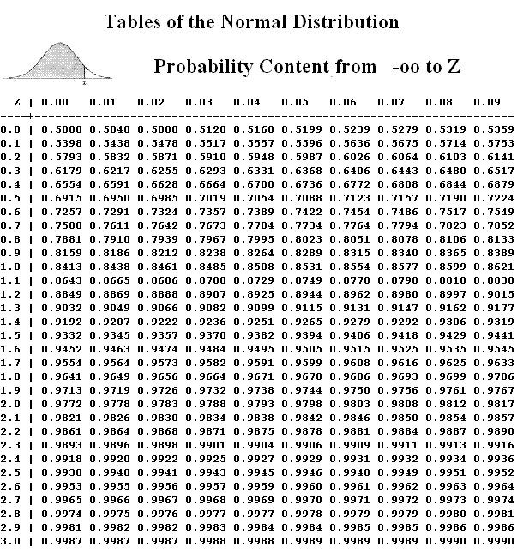
Z-score table - % Area to the left of z
This Photo by Unknown Author is licensed under CC BY-SA

Slide 9
Finding areas under the standard normal curve
Locate on the table the line containing the first two digits of the z-score.
Then go over to the column containing the 3rd digit of the value and locate the number in the intersecting column and row. That’s the area!
Notice that the area can be read as a percent if you move the decimal point two places to the right and attach the % sign.

Slide 10
Can you see that the area under the curve to the left of z = 1.92 is 0.9726 or 97.26%?
This Photo by Unknown Author is licensed under CC BY-SA

Slide 11
Finding the area to the left for Negative z-Scores
When a given value of z is a negative number you find the area to the left of it by subtracting the z-Score of the corresponding positive z from 1.000.
For example, the z-Score of -1.52 is calculated by first finding the area to the left of 1.52 which you see by the table is 0.9357.
The area to the left of z = -1.52 is
1.000 – 0.9377 = 0.0643 = 6.43%

Slide 12
Area under the curve between two values of z
The area under the curve between any two z-scores represents the probability of a data value being between those scores.
To find the area between two z-scores just subtract the smaller area from the larger.

Slide 13
Example: Finding the area under the curve between z = 1 and z = 2
Use the z-score table to find the percent of data between z = 1.000 and z = 2.000.
The area left of z = 2.000 is 0.9772 and the area left of z = 1.000 is 0.8413
So the are between them is
0.9722 – 0.8413 = 0.1359 or about 13.6%

Slide 14
The Empirical Rule for estimating the area between whole number values of z.
The empirical rule states the percentage of normally distributed data that falls within 1, 2 and 3 standard deviations from the mean:
68% of the data falls within 1 standard deviation of the mean.
95% of the data falls within 2.
99.7% of the data falls within 3.

Slide 15
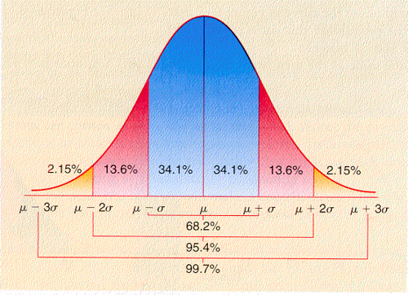
Area under the curve where $σ$ is one standard deviation.
This Photo by Unknown Author is licensed under CC BY-NC-ND

Slide 16
YouTube Video

